Slide 1
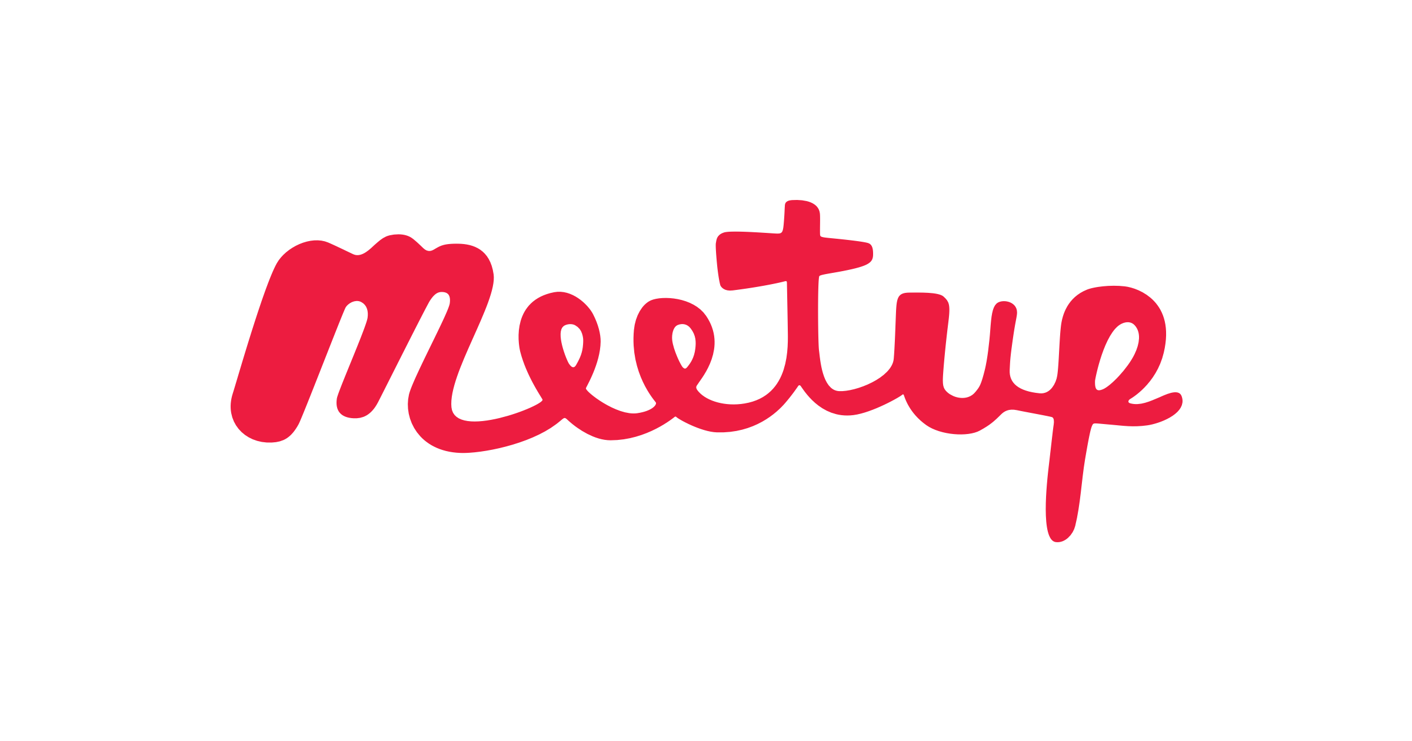
Day 1
- Subramanya Joshi

Slide 2
Agenda
Introduction
This is the discussion or training about a programming language or any technology
Lets define and solve an abstract problem
Meet often and try to code
Feel free to ask question

Slide 3
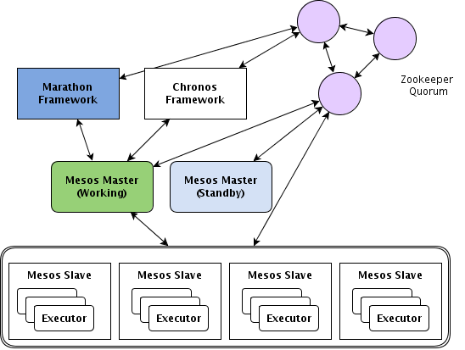
Problem Statement

Slide 4
Possible Solutions
Make the code more reliable - exception handling, etc
Have HA setup
Monitor and Restart on failure

Slide 5
Possible Solutions
Program to monitor on a regular interval
Restart the failed application
and Repeat
A program written Golang
Golang is like C and best for system programming
Use of threads to make it scalable
Single executable can be cross compiled

Slide 6
Possible Solutions
<Code/>
https://github.com/HackRanger/lti-meetup/tree/master/day-1

Slide 7
More Problems
Suitable for stateless applications
We can do this if the application is stateful
Complex restart procedure – like starting dependent services

